Slide 1
Locating a restaurant in an airport

Slide 2
Presentation Guidelines
Motivation and Summary
Questions and Data
Data Cleanup and Exploration
Data Analysis
Discussion
Post Mortem
Questions

Slide 3
Motivation and Research
During our discussions, we found out that our team loves to travel and eat really good food. We have each traveled extensively to many domestic and international locations. Many times we have each found ourselves pressed for time and scrambling to find a decent meal or some snack items that we have been craving.
The last thing either of us wants is to get on a long flight where we did not get a chance to eat or ate the wrong thing ☹ We have each found it tough to locate a decent place to eat because we were not familiar with the airport or did not have a reliable Uber source to point is in the right direction. As a result we chose to invest our project resources in the development of an application that would make it easier for its users to travel through and locate areas of interest within any nationally recognized airport within the United States. Although we have seen a few attempts at developing something of this nature, we feel as though our experience and perspective will yield a better more useful application.
Yelp API
FAA
Food Network
Instructor Provided Data
Notes:
QuickStarter has created an outline to help you get started on your presentation. Some slides include information here in the notes to provide additional topics for you to research.

Slide 4
Questions and data
Airports in all 50 states
Terminals at each airport
Airlines in each terminal
Restaurants in each airport with a rating
Data Concessions

Slide 5
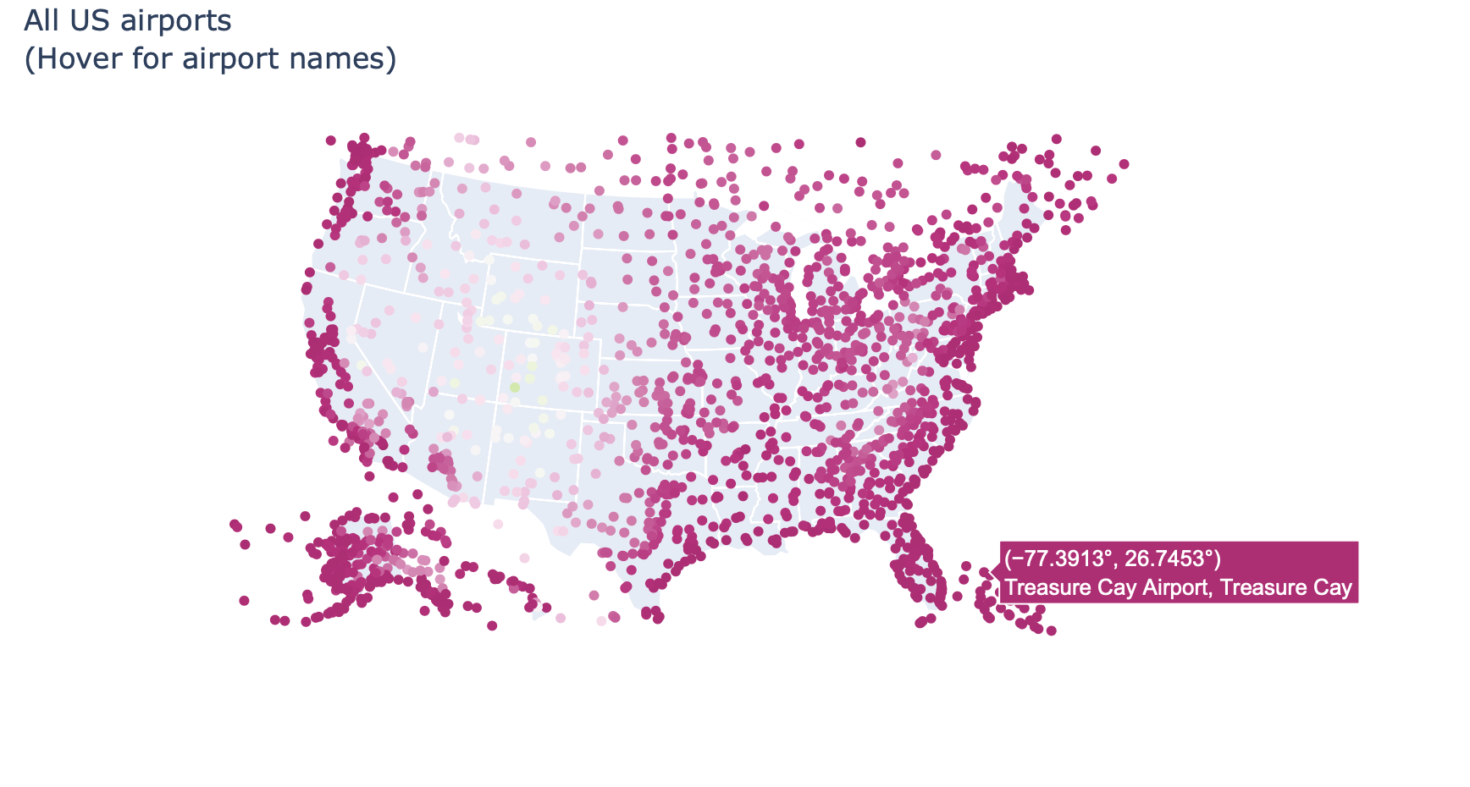
All US airports (Heat map)

Slide 6
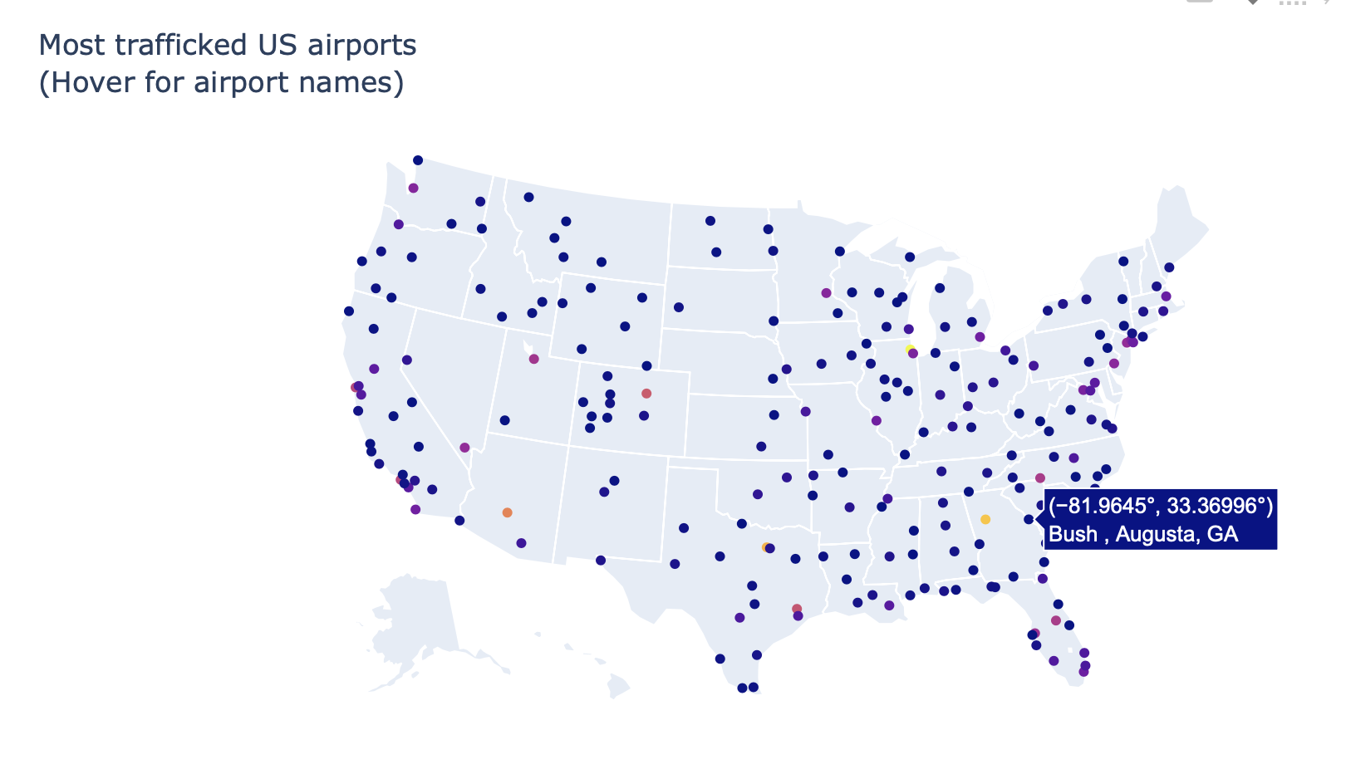
Creation data Frame(Airport) (Heat map)

Slide 7
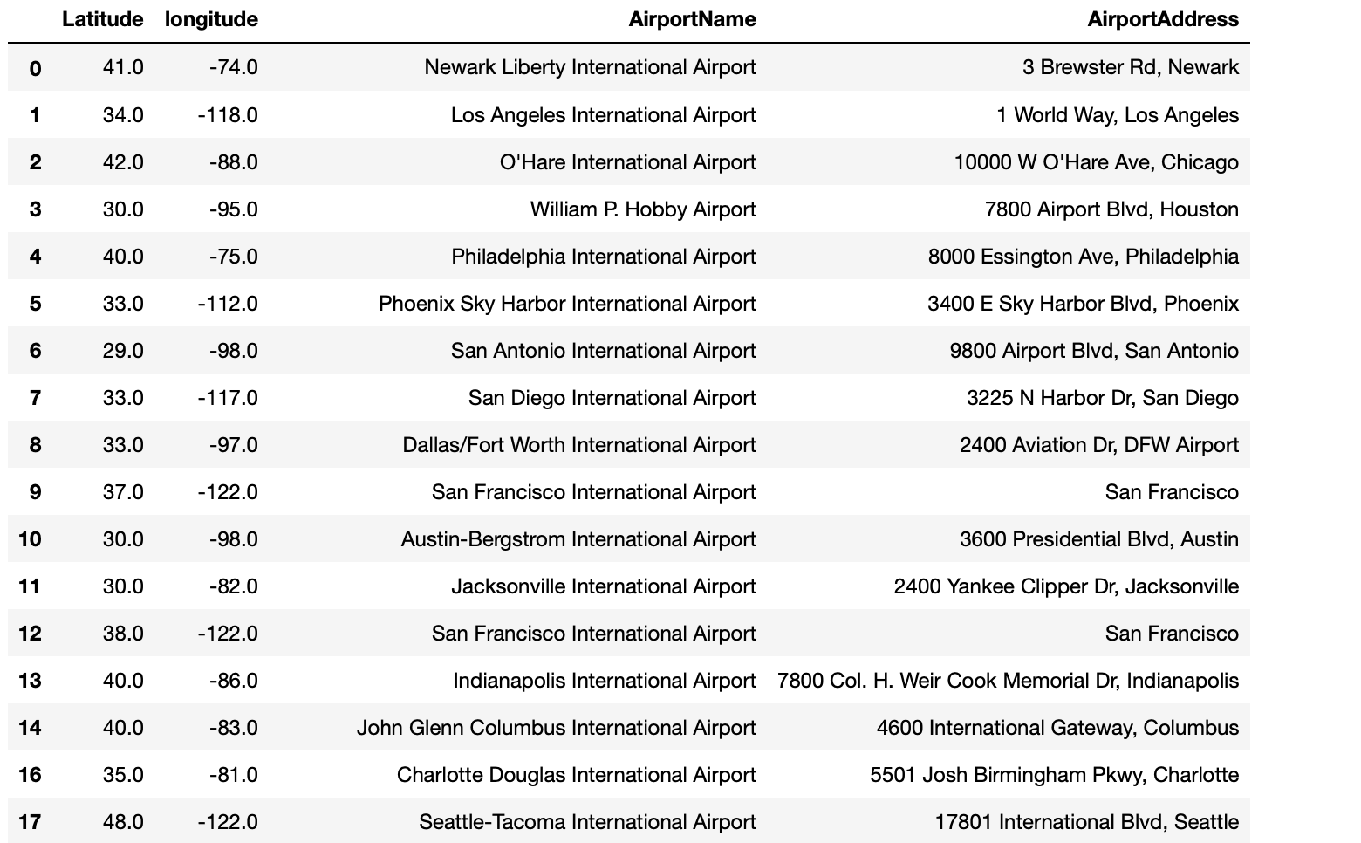
Creation of data Frame (airport by City in the US)

Slide 8
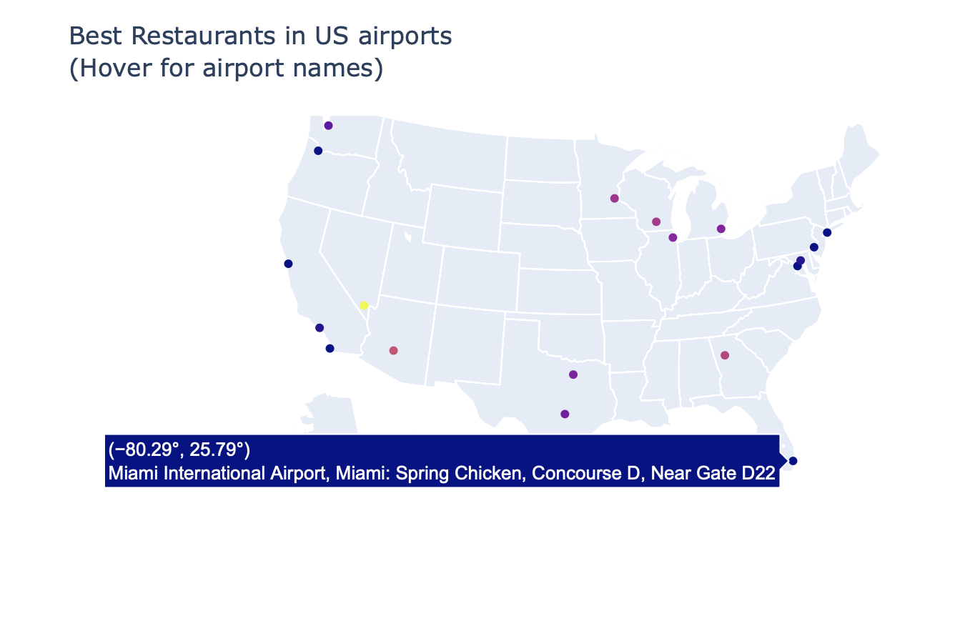
Best restaurants in the US airports (Heat map)

Slide 9
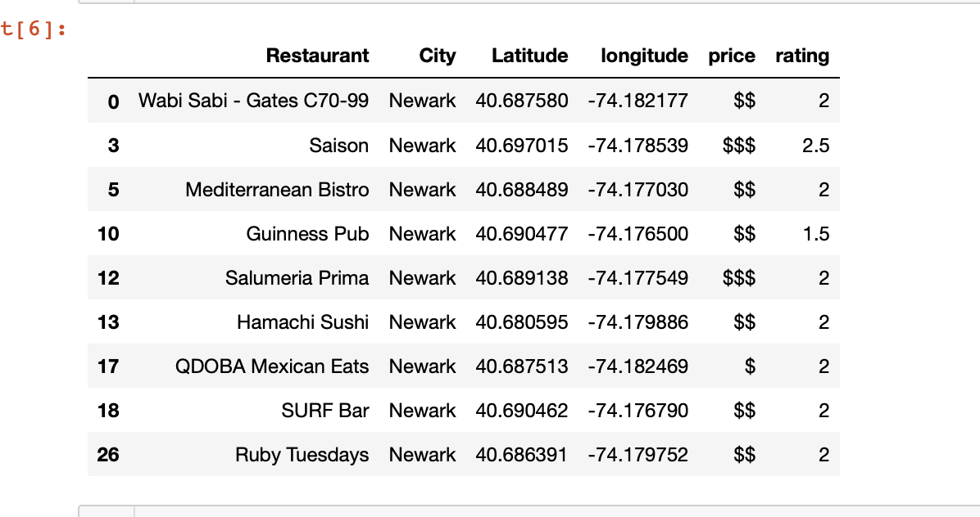
Creation of data Frame (Restaurants within one KM radius of the airport )

Slide 10
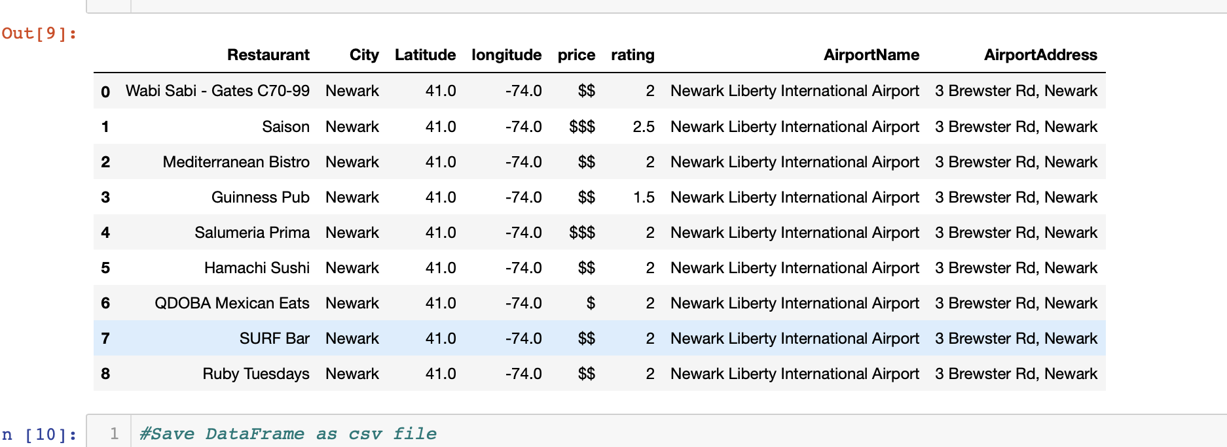
Creation of data Frame (merge of Restaurants and airport by lat/lon)

Slide 11


Summary
During this project we found that it was critical for us to thoroughly understand the task prior to starting. In order for us to successfully execute this project we had to do the following:
Define the Scope
Research and white board
Define the data sources
Retrieve and Clean all data sources
Remove duplicates
Account for N/A
Rounded decimals for lat/lon match
Code in blocks
Perform errors checks
Modify code to enhance results
Notes:
QuickStarter has created an outline to help you get started on your presentation. Some slides include information here in the notes to provide additional topics for you to research.

Slide 12

Questions

